Slide 1
CSCI 1101 Introduction to Computer Science
Representing Non-numeric Data

Slide 2
Representing Text
What must be provided to represent text?
There are finite number of characters to represent, so list them all and assign each a binary string
Character set
A list of characters and the codes used to represent each one
Computer manufacturers agreed to standardize

Slide 3
The ASCII Character Set
ASCII stands for American Standard Code for Information Interchange
ASCII originally used seven bits to represent each character, allowing for 128 unique characters
Later extended ASCII evolved so that all eight bits were used
How many characters could be represented?

Slide 4
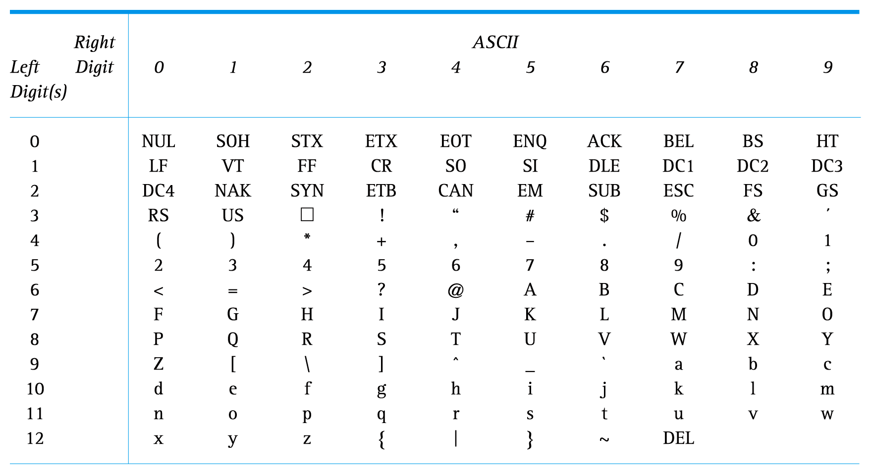
ASCII Character Set Mapping

Slide 5
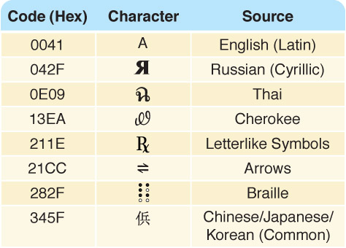
The Unicode Character Set
Figure 3.6 A few characters in the Unicode character set

Slide 6
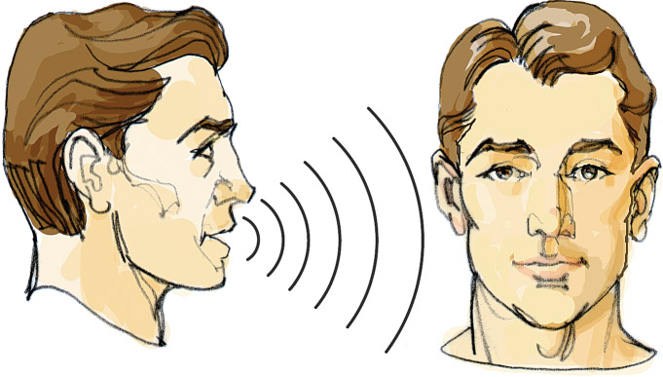
Representing Audio Information
We perceive sound when a series of air compressions vibrate a
membrane in our ear, which sends signals to our brain

Slide 7
Representing Audio Information
Digitize the signal by sampling
periodically measure the voltage
record the numeric value
How often should we sample?
A sampling rate of about 40,000 times per second is enough to create a reasonable sound reproduction

Slide 8
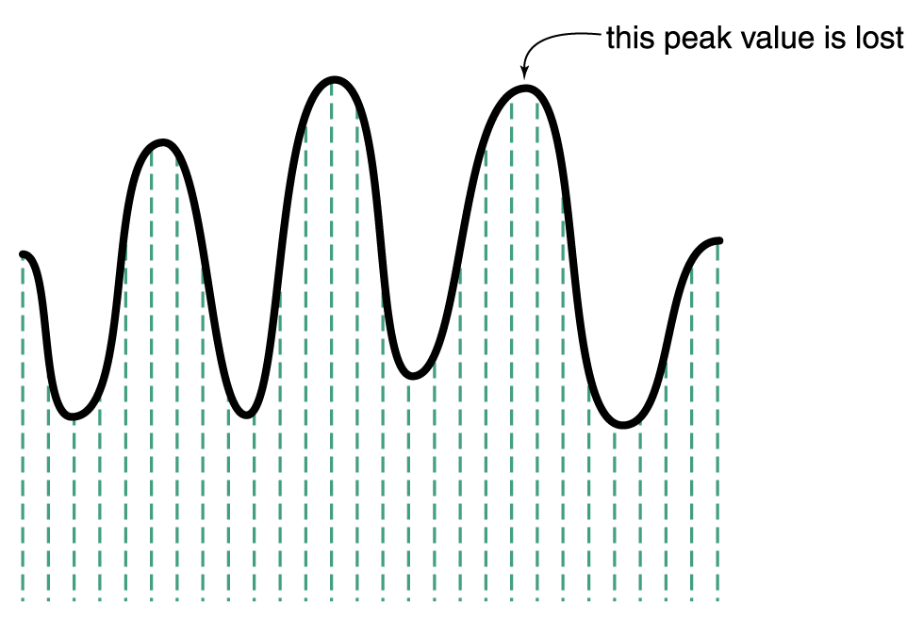
Representing Audio Information
Some data
are lost, but a
reasonable
sound is
reproduced
Figure 3.8 Sampling an audio signal

Slide 9
Representing Images and Graphics
Color is expressed as an RGB (red-green-blue) value
These three numbers indicate the relative contribution of each of these three primary colors of light
Each color value is represented as one byte, so each color value ranges from 0 to 255
This 3-byte color is called true color.

Slide 10
Representing Images and Graphics
RGB example:
An RGB value of (255, 255, 0) maximizes the contribution of red and green, and minimizes the contribution of blue, which results in a bright yellow

Slide 11
Representing Images and Graphics
Remember that we are talking about additive color mixing (mixing light)… (used in displays)
… not subtractive color mixing (mixing pigments) (used in printers). Example, CMYK

Slide 12
Representing Images and Graphics
Do we really “need” all those bits?
Number of colors we can represent with 24- bit true color = 2²⁴ = 16.7+ million
Number of colors humans can perceive = ?
Low end: 100,000
High end: 10 million

Slide 13
Digitized Images and Graphics
Digitizing a picture
Representing it as a collection of individual dots called pixels
Resolution
The number of pixels used to represent a picture
Raster Graphics
Storage of data on a pixel-by-pixel basis
Bitmap (BMP), GIF, JPEG, and PNG are raster-grahics formats

Slide 14
Digitized Images and Graphics
Bitmap format
Contains the pixel color values of the image from left to right and from top to bottom
GIF format (indexed color)
Each image is made up of only 256 colors
JPEG format
Averages color hues over short distances
PNG format
Like GIF but achieves greater compression with wider range of color depths
Which is better for line drawings? Pictures?
For more information about formats check:
http://www.scantips.com/basics09.html

Slide 15
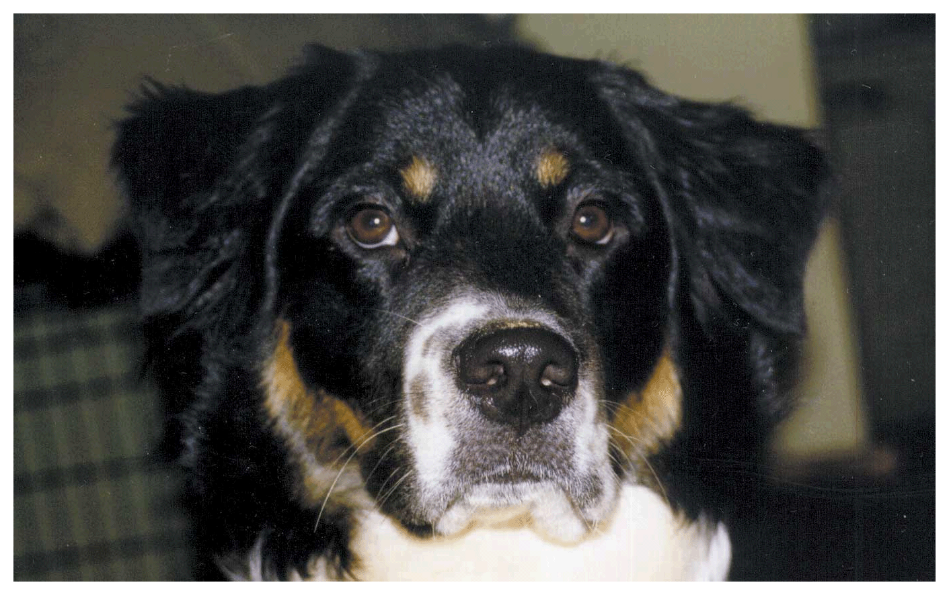
Digitized Images and Graphics
Whole
picture
Figure 3.12 A digitized picture composed of many individual pixels

Slide 16
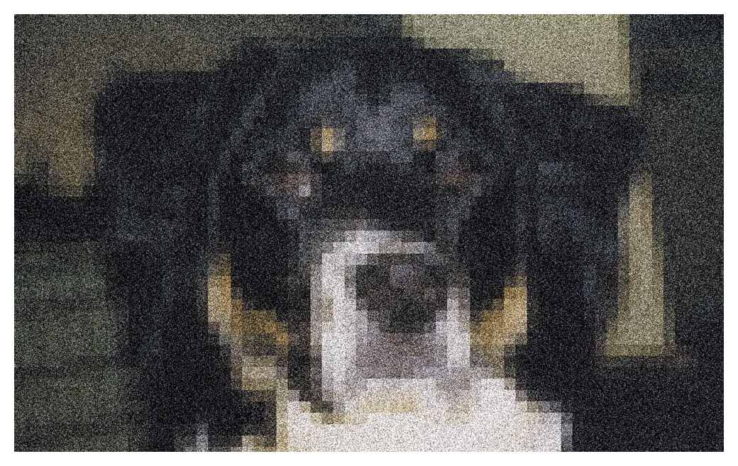
Digitized Images and Graphics
Magnified portion
of the picture
See the pixels?
Figure 3.12 A digitized picture composed of many individual pixels

Slide 17
Vector Graphics
Vector graphics
A format that describes an image in terms of lines and geometric shapes
A vector graphic is a series of commands that describe a line’s direction, thickness, and color
The file sizes tend to be smaller because not every pixel is described

Slide 18
Vector Graphics
The good side and the bad side…
Vector graphics can be resized mathematically and changes can be calculated dynamically as needed
Vector graphics are not good for representing real-world images

Slide 19
Representing Video
Video codec COmpressor/DECompressor Methods used to shrink the size of a movie to allow it to be played on a computer or over a network
Almost all video codecs use lossy compressions to minimize the huge amounts of data associated with video

